Slide 1

Snake Game
Project 1 - LEDs
Evan Huang
ID620 Embedded Systems

Slide 2
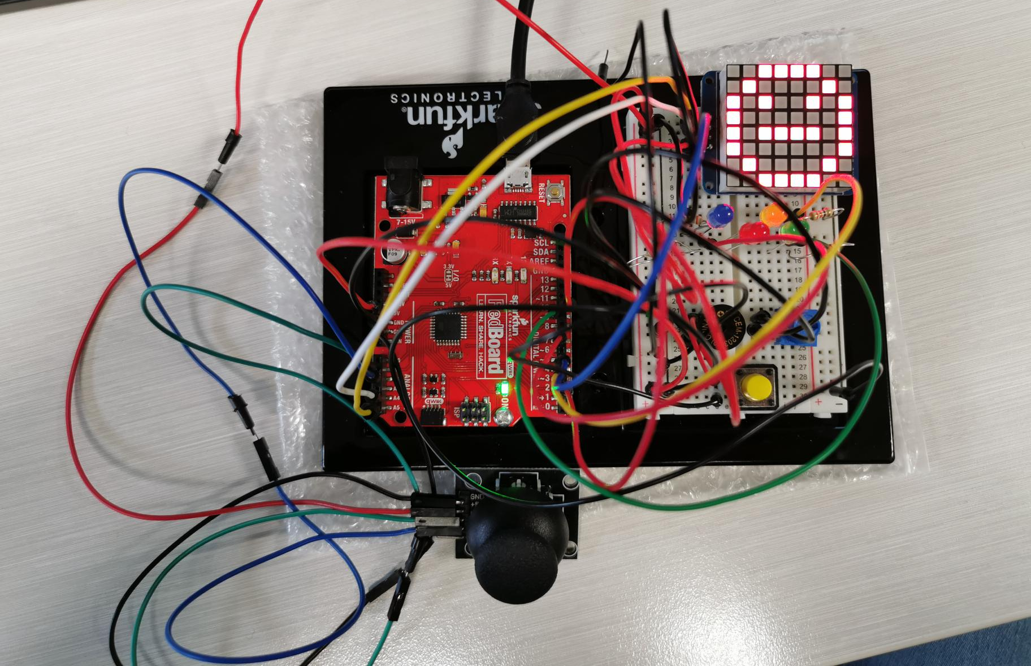
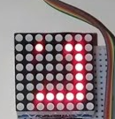

Introduction
This is an Arduino sketch for a classic Snake game on an 8x8 LED matrix. The game is controlled with a joystick and features four LEDs and a buzzer for additional feedback. The player's goal is to guide the snake to eat a randomly placed fruit while avoiding collision with the walls and the snake's body. The game ends when the snake collides with a wall or its own body. The restart button is used to start a new game after the current one has ended.

Slide 3
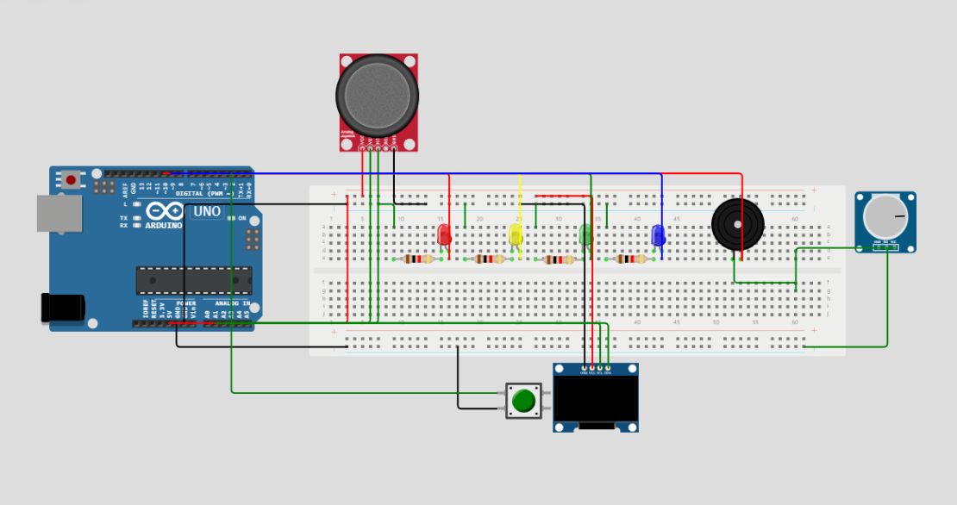
Circuit Diagram
Components:
RGB Leds
Joystick
8x8 Led Matrix
Buttons
Potentiometer
Piezo Buzzer
Resistors
Jumper wires

Slide 4
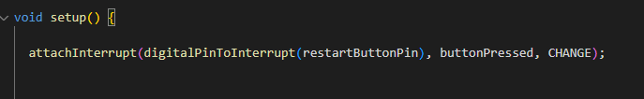
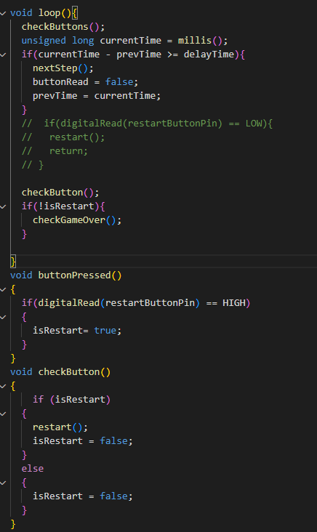
Challenge
Interrupts

Slide 5
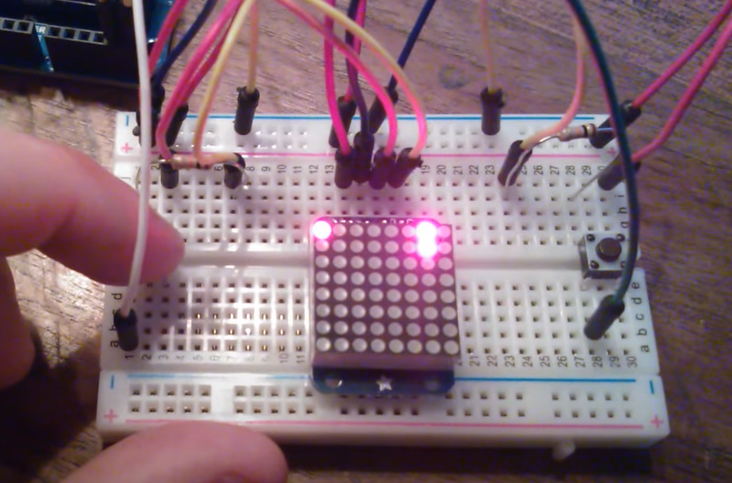
References
Snake-game on Arduino using 8x8 matrix of AdaFruit
https://www.youtube.com/watch?v=heAeEHbYDls
https://fritzing.org/projects/snake-8x8-led-matrix-ada-fruit
2. Adafruit LED Backpacks
https://learn.adafruit.com/adafruit-led-backpack/downloads
Libraries:
Adafruit LED Backpack
Adafruit GFX

Slide 6


Thank You
Presenter: Evan Huang
Email address : haunh8@student.op.ac.nz
GitHub : https://github.com/huanh8/Embaded-System/tree/main

